Slide 1

Machine Learning for Customer Churn with Watson Studio
Your Names Go Here
Technical Evangelist Team

Slide 2
Data Science and Machine Learning with the Watson Data Platform
IBM Cloud
Technical Evangelist Team

Slide 3


Introductions
Louis Frolio
Technical Evangelist, IBM
Loren Murphy
Technical Evangelist, IBM

Slide 4
Session Overview
Description | The goal of this session is to familiarize participants with the Watson Data Platform; specifically the Watson Studio and Watson Machine Learning. This will be one within the context of analyzing customer churn.
Audience | Intended for individuals seeking to develop a basic understanding of data science and machine learning.
Pre-requisites | Pre-requisite skills: Business Intelligence Conditioning and management of business data Familiarity with basic statistics
Notes:
The pre-reqs are recommended but not requires. This course and the lab can be relevant to all parties

Slide 5
Session Objectives
Upon completion of this session, you should be able to:
Execute a notebook in the Watson Studio
Deploy a Machine Learning Model
Understand the Tools, Technology, and Processes involved in Data Science and Machine Learning
Notes:
Feel free to ask questions through out
The point of today is to challenge you, teach you much and have fun!

Slide 6
Section 1
Introduction to Data Science

Slide 7
Objectives
Upon completion of this section, you should be able to:
Define Analytics
Differentiate Between Data, Information, and Knowledge
Discuss Data Science & the Role of the Data Scientist
Describe the Data Science Methodology
List Examples of Tools & Technology Used in Data Science

Slide 8
Analytics
A definition
“Analytics are the quantifiable informational inputs that use past data
to identify possible trends that may provide valuable insight for future action.” ⁽²⁾
Pixabay. Analytics Word Cloud ⁽¹⁾
Notes:
[1] Image. Analytics Word Cloud. https://pixabay.com/en/analytics-business-resources-wordle-1368293/
[2] Frolio, Louis. “Foundations of Data Science and Analytics” Week 6, Topic note 1 (2014) Brandeis University, Fall Semester, 2014

Slide 9
Analytics
Data’s journey to value
Wisdom
Given Insight, Becomes
Knowledge with insight: understanding, integrated, actionable.
e.g. Walk a bit more to achieve daily average
Knowledge
Information in context: understanding and meaning.
Contextual, synthesized, learning.
e.g. 4000 steps per day is less than my daily average
Given Meaning, Becomes
Information
Data with Interpretation: useful, organized, structured.
e.g. 4000 steps
Given Context,
Becomes
Data
Raw Data: objective facts about an event.
e.g. 4000
Charles Sturt University. Data and Knowledge⁽¹⁾
Notes:
[1] Information. Charles Sturt University. https://www.csu.edu.au/division/dit/eal/portfolios/information

Slide 10
Analytics
Data structure types
Transactional Data
Structured
Defined data type, format, and structure
Textual data with a discernable pattern, enabling parsing
Self describing XML with schema
Semi-Structured
Textual data with erratic data formats, can be formatted with effort, tools, and time
Clickstream data
Quasi-Structured
Data that has no inherent structure and is usually stored in different file types
PDF, Excel, JPG
Unstructured
Notes:
“The graphic shows different types of data structures, with 80-90% of the future data growth coming from non-structured data types (semi, quasi and unstructured).
Although the image shows four different, separate types of data, in reality, these can be mixed together at times. For instance, you may have a classic RDBMS storing call logs for a software support call center. In this case, you may have typical structured data such as date/time stamps, machine types, problem type, operating system, which were probably entered by the support desk person from a pull-down menu GUI.
In addition, you will likely have unstructured or semi-structured data, such as free form call log information, taken from an email ticket of the problem or an actual phone call description of a technical problem and a solution. The most salient information is often hidden in there. Another possibility would be voice logs or audio transcripts of the actual call that might be associated with the structured data. Until recently, most analysts would NOT be able to analyze the most common and highly structured data in this call log history RDBMS, since the mining of the textual information is very labor intensive and could not be easily automated.” ⁽¹⁾
[1] Dietrich, D. Heller, B. Yang, B. (2015). Data Science and Big Data Analytics. Wiley.

Slide 11
Data Science
A definition
“Data science, also known as data-driven science, is an interdisciplinary field about scientific methods, processes,
and systems to extract knowledge or insights from data in various forms, either structured or unstructured.”⁽¹⁾
* Term first used in publication in 1974
* Introduced as an independent discipline in 2001
Notes:
[1] https://en.wikipedia.org/wiki/Data_science

Slide 12

Data Scientist
Modern day unicorns
Skeptical
Must be able to examine their own work critically
Quantitative
Skilled in mathematics or statistics
Curious & Creative
Passionate about finding creative ways to solve problems and portray information
Technical
Aptitude for software engineering, programming, and machine learning
Tveten,J . Data Science 101 ⁽¹⁾
Communicative & Collaborative
Strong verbal and written skills. Must be able to articulate business value and collaborate with others.
Notes:
“Harvard Business Review called the modern data scientist the “sexiest job of the 21st century”. Companies are sitting on mountains of data assets, without the proper skills and tools to translate the data into business value. Enter the modern data scientist. These difficult-to-find individuals have the complete skill set needed to take one of the world’s most mispriced assets – data -- and use it to improve the economics of the firm.
Here we see some of the skills that people in the Data Science field bring to the office everyday. The data scientist has a strong background in mathematics and statistics, along with the programming and database expertise needed to build maintainable applications. As data volumes continue to grow, there is also as emphasis on the need for expertise in distributed computing and understanding algorithm computational complexity. And like any good companion, the data scientist is an excellent communicator. They can articulate the stories in the data and how data products can be used to improve business processes.
It’s also interesting to note their education – this likely surprises a number of people that data science isn’t a collection of PhDs – not at all
The term “data science” like “big data,” is not precisely defined but can be described by its principal characteristics and functions:
Quantitative
Skilled in mathematics or statistics
Curious & Creative
Passionate about finding creative ways to solve problems and portray information
Communicative & Collaborative
Strong verbal and written skills. Must be able to articulate business value and collaborate with others.
Skeptical
Must be able to examine their own work critically
Technical
Aptitude for software engineering, programming, and machine learning” ⁽²⁾
[1] Image Credit: http://www.builtinla.com/2014/09/03/data-science-101-what-data-scientist-does-and-how-become-one
[2] Brandon MacKenzie. (2015). Building Data Science Teams. https://w3-connections.ibm.com/files/app#/file/843f860b-7e68-4d36-a5c1-44a8d6982820

Slide 13
Data Science Team
Data Engineer
Data Scientist
Quantitative Analyst
Data Analyst
Front-end Developer
Business Expert
Data ingestion pipelines
Wrangling, exploring, and hacking data
R&D advanced mathematical algorithms
Test hypothesis, creates data driven reports
Develop end-user applications
Identify business opportunities
Notes:
“Before we can think about building a data science team, we need to understand what data science is really all about. It’s about solving problems. Everything we do in data science is rooted in this underlying methodology for data science that you see on the right-hand side of the screen. This methodology provides a guiding strategy, regardless of the technologies, data volumes, approaches, or human resources.
Building a successful data product requires the concatenation of several skill sets. As you can see in the data science methodology, there are several phases in which collaboration between various roles is required. The romantic idea of a single person having the complete skillset to build data products is actually possible – these people do exist -- but they are very rare.
In practice, several people work on a team (it could be a cross-functional team) to build a data product. These people bring a variety of skill sets to the table – the deeper programming types such as data engineers and front-end developers bring consumability to data science. The mathematics types use statistical algorithms to find patterns in data. And throughout the process, everything needs to be aligned with driving business outcomes – guided by the eye of domain expertise.
Here I’ve discretized the typical clustering of skill sets that you see in a high-performing data science team into 6 categories: the Data Engineer, Data Scientist, Quantitative (“Quant”) Analyst, Data Analyst, Front-end Developer, and Business Expert. Now, we’ll look at how each of these roles compare and what these groups of people actually do.
Background: Please read the “Foundational Methodology for Data Science” white paper and/or take the equivalent data science methodology course on BigDataUniversity.com.”
[1] Brandon MacKenzie. (2015). Building Data Science Teams. https://w3-connections.ibm.com/files/app#/file/843f860b-7e68-4d36-a5c1-44a8d6982820

Slide 14
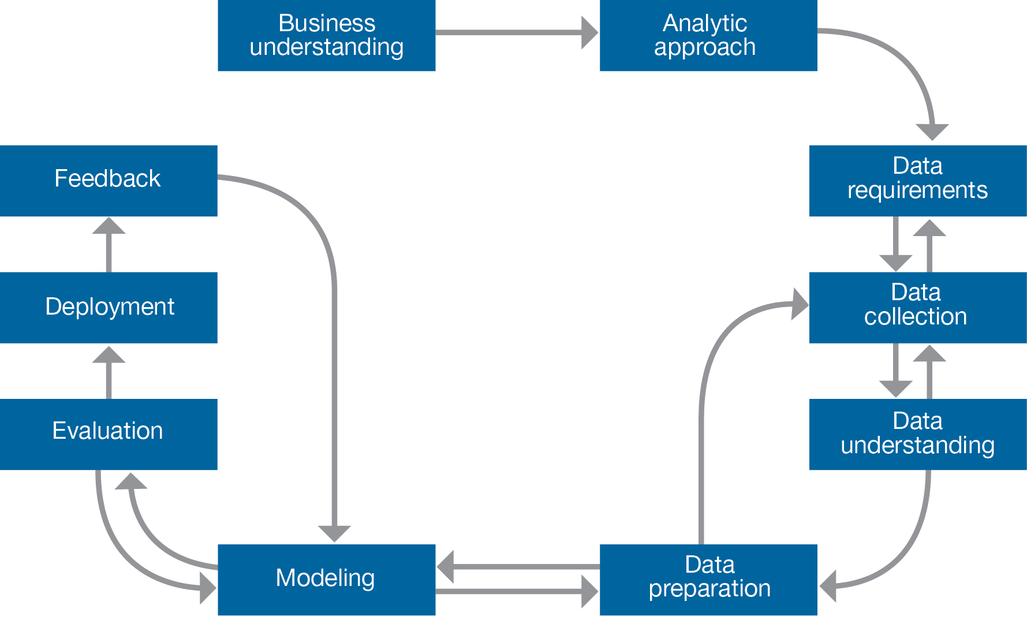
Data Science Methodology
Methodology diagram
Notes:
“Such a methodology is illustrated in this figure. It bears some similarities to recognized methodologies for data mining, but it emphasizes several of the new practices in data science such as the use of very large data volumes, the incorporation of text analytics into predictive modeling and the automation of some processes.
Looking at this diagram, we immediately spot two outstanding features of our methodology:
First, it is highly iterative, meaning that we typically iterative between stages throughout the problem-solving process.
Second, there is no endpoint, meaning that the process remains in play as long the problem is relevant.”⁽¹⁾
[1] John B. Rollins. (2015) Foundational Data Science Methodology. https://w3-connections.ibm.com/files/app#/file/ac78b93f-9fe8-465c-a054-2409184bb861

Slide 15
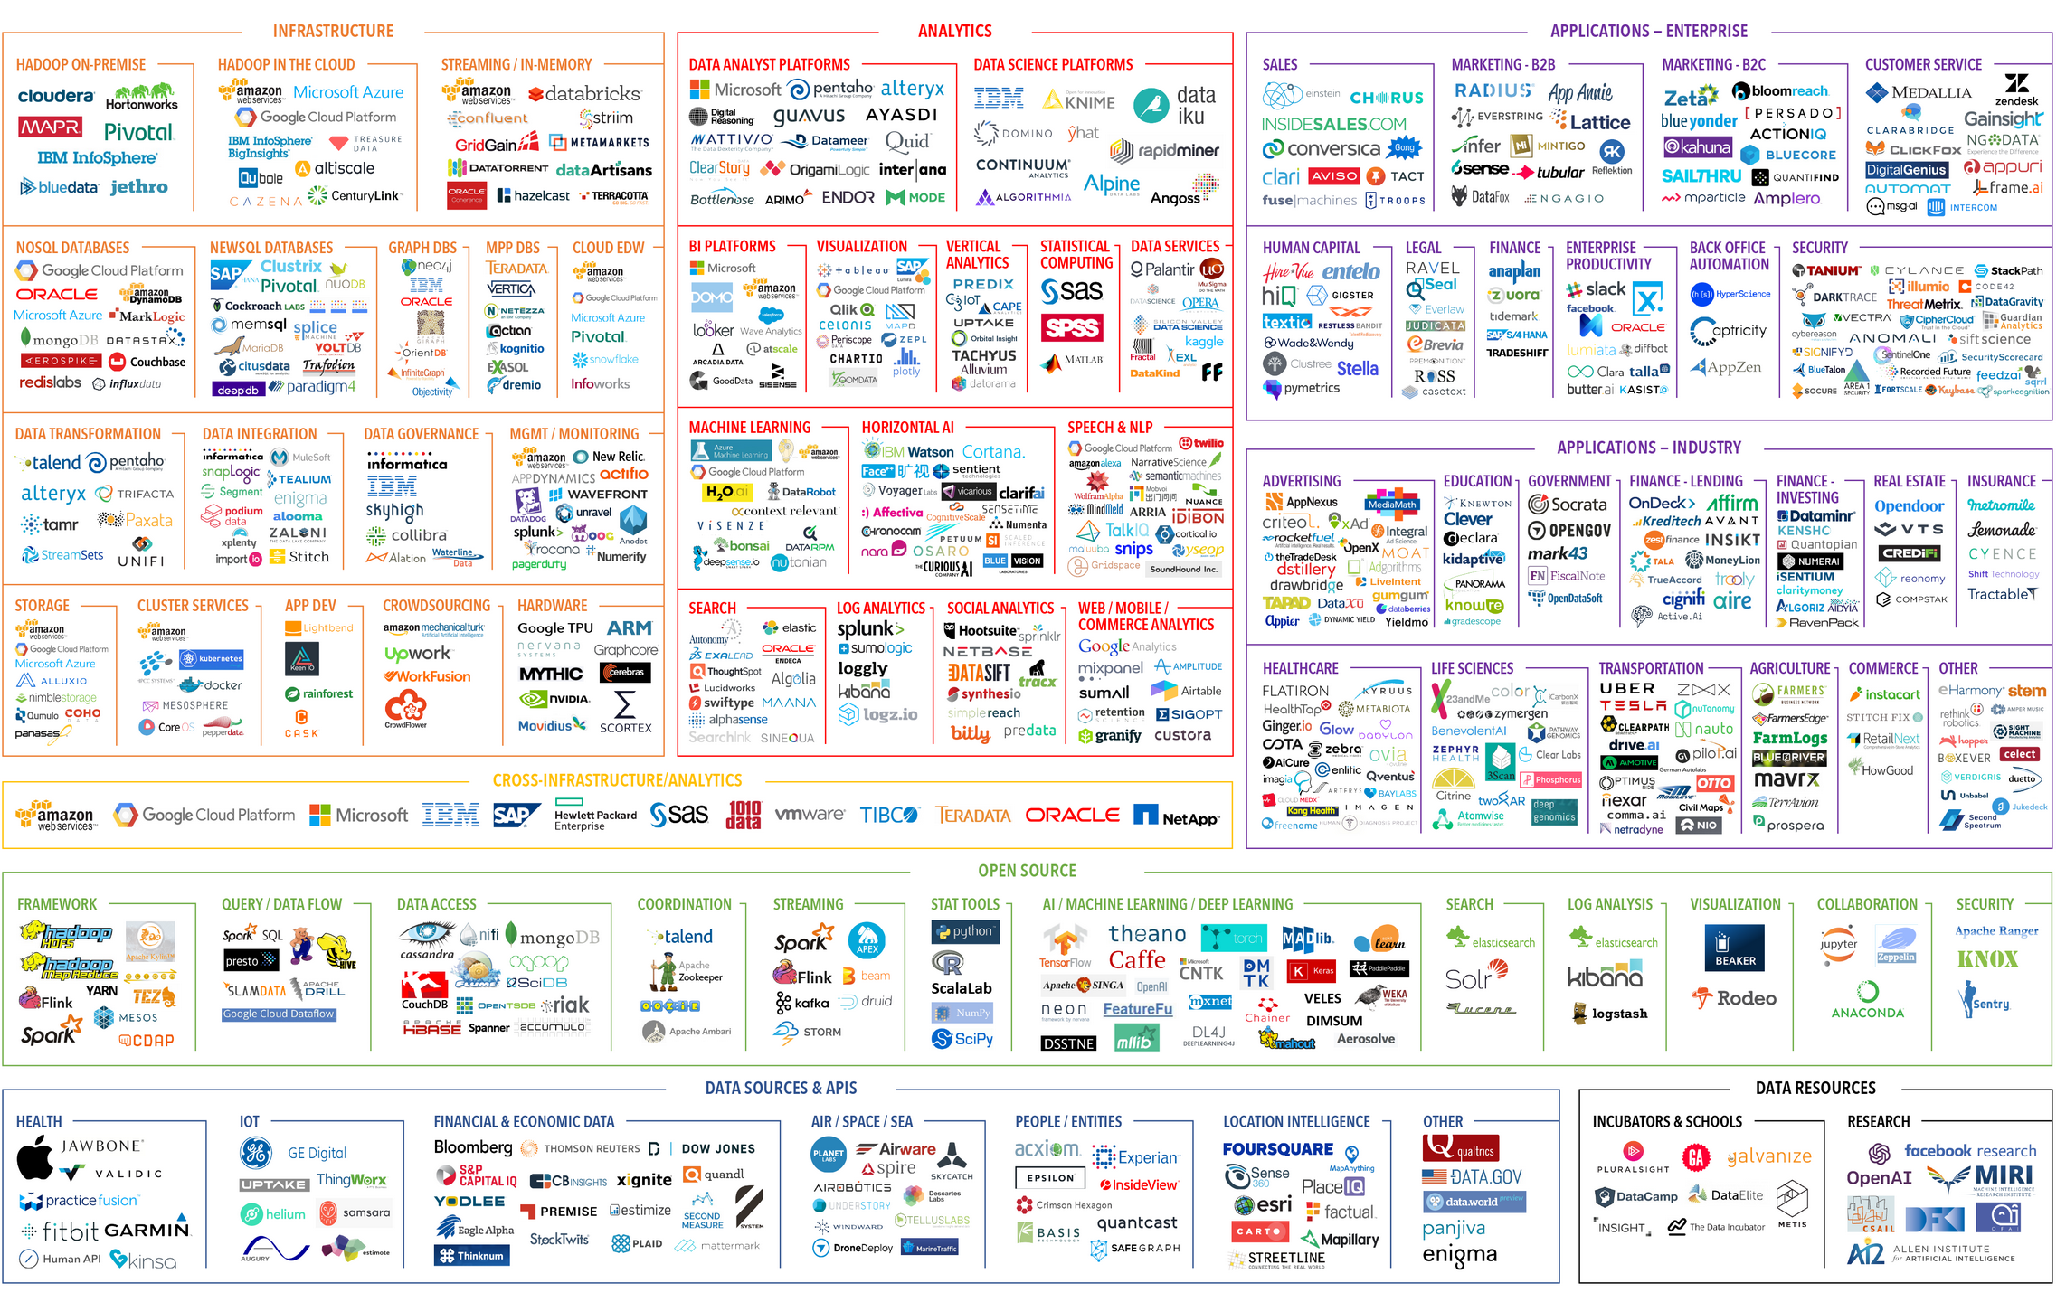
Tools for Data Science

Slide 16
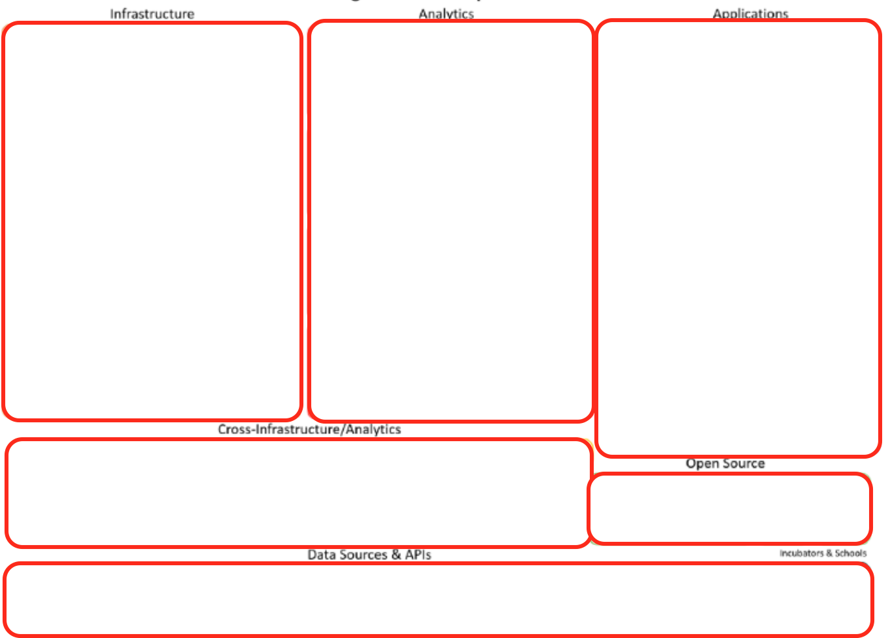
Tools for Data Science
Power systems
IBM Cloud
Watson Studio
SPSS
Cognos
Watson Health
Watson HR
Watson Data Platform
IBM Cloud
Spark,Jupyter/R/Python
Weather Company, Watson Studio Community Data
Notes:
OOO GIRLL YESSSL, love it!

Slide 17
Section 1: Summary
Key points covered in this section:
Relationship Between Data, Information, and Knowledge
Key Characteristics of Data Science, and the Data Scientist
Data Science Methodology
Tools & Technology Used in Data Science by Data Scientists

Slide 18
Section 2
Introduction to Machine Learning

Slide 19
Objectives
Upon completion of this module, you should be able to:
Define Machine Learning
Differentiate Between Labeled and Un-labeled Data
Describe the Main Categories of Machine Learning
Notes:
This module provides a brief introduction to machine learning including its definition. Key terminologies that distinguish between the various categories of machine learning are discussed along with definitions of the various types of data used in machine learning.

Slide 20
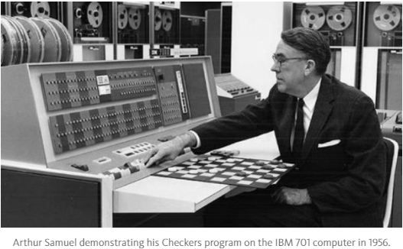
Overview of Machine Learning
Term first coined by an ibMer (circa 1950’s)
“Machine Learning is the field of study that gives computers the ability to learn without being explicitly programmed.”
Arthur Samuel, Artificial Intelligence Pioneer – IBM Corporation.
Notes:
Let’s first take an overview of where machine learning from and what is machine learning. The term “machine learning” was first introduced in the early 1950’s by an IBM researcher named Arthur Samuel⁽¹⁾.
Arthur was an early pioneer of artificial intelligence and gaming; in fact, his early research was focused on teaching a computer to play checkers⁽²⁾. As you know that Alpha-go beat the No1 Go-player now. And that’s how you can see machine learning migrated from there to here.
Let see what he had said about machine learning –
“Machine learning is as its name, it is a machine is learning based on sets of data that it recognized.” ⁽¹⁾
[1] IBM Journal of Research and Development “Some studies in machine learning using the game of checkers.” Volume 44 Issue 1.2
http://ieeexplore.ieee.org/document/5389202/?reload=true&arnumber=5389202
[2] Solving the Game of Checkers. Schaeffer, J. Lake, R. (1996). http://library.msri.org/books/Book29/files/schaeffer.pdf

Slide 21
Overview of Machine Learning
ML is the natural intersection of two disciplines
Computer Science
Statistics
Machine Learning
How we build machines that solve problems.
What conclusions can be inferred from data.
How do we get computers to program themselves.
Notes:
“Machine Learning is a natural outgrowth of the intersection of the following two disciplines”.
Computer science: We might say the definition of Computer Science is “How can we build machines that solve problems, and which problems are inherently tractable/intractable?”
Statistics: The question that largely defines Statistics might be “What can be inferred from data plus a set of modeling assumptions, and with what reliability?”
And when computer science and statistics come together, there is where the machine learning. It combines with both features, and also let the computers program themselves. So machine learning means to capture useful information from data by teaching the computers program themselves by some computational architectures or algorithms.
And actually machine learning is the foundation of AL and deep learning. That’s you can see how important it is.
“Whereas Statistics has focused primarily on what conclusions can be inferred from data, Machine Learning incorporates additional questions about what computational architectures and algorithms can be used to most effectively capture, store, index, retrieve and merge these data, how multiple learning subtasks can be orchestrated in a larger system, and questions of computational tractability. ” (1)
[1] Mitchel, T. (2006). The Discipline of Machine Learning. Carnegie Mellon University. http://www.cs.cmu.edu/~tom/pubs/MachineLearning.pdf

Slide 22

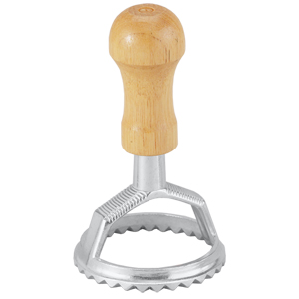
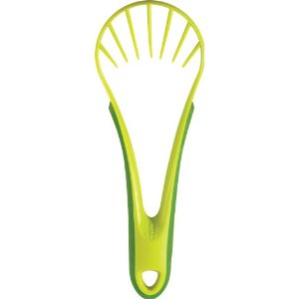
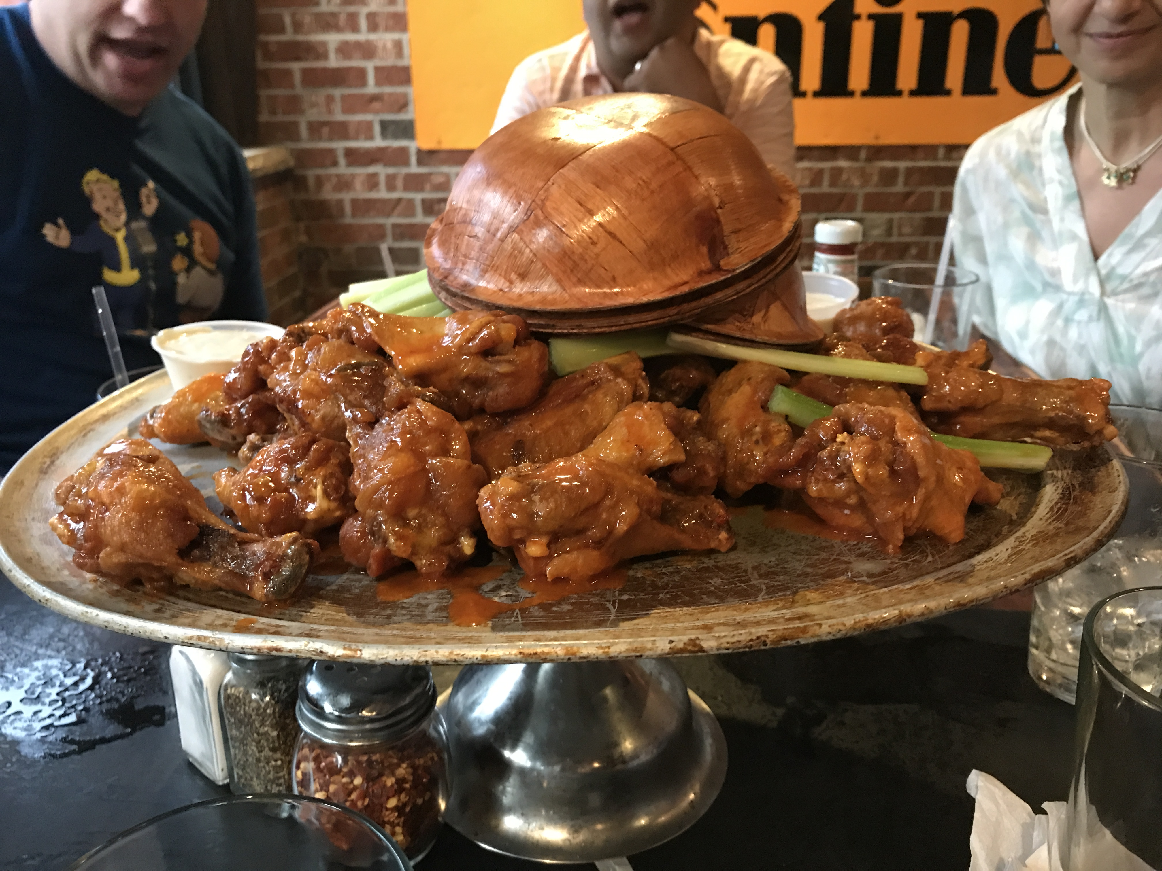
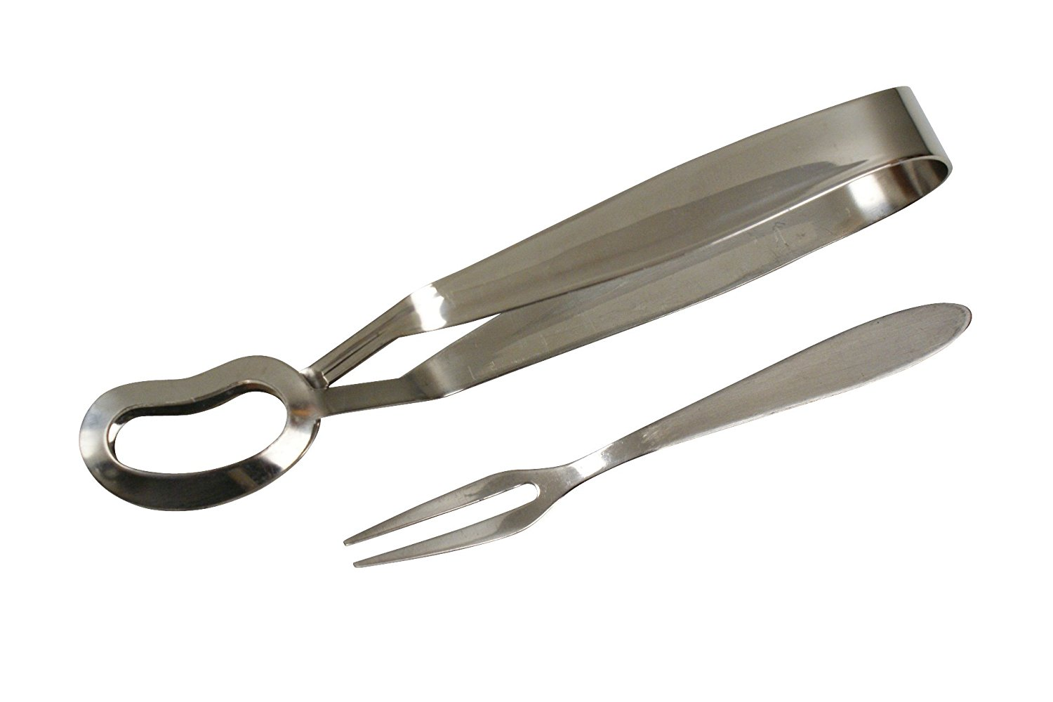
Types of Data in Machine Learning
Labeled
Unlabeled
Cat
?
?
Hot Wings
?
Notes:
When working with machine learning algorithms, the data it uses is broken down into two camps, labeled, and unlabeled.
Labeled data refers to data that has been identified and assigned a label. Examples include the identification of a disease for a given patient, identifying that an image is that of a cat, or an indication that a person who applies for credit will be a credit risk.
Unlabeled data is the opposite, there exists no clear label or indication. A photograph, where you do not recognize the faces and where there is no name associated with it is just one example.

Slide 23
Main Categories of ML
Supervised
All Labeled Data
Model
All Unlabeled Data
Model
Unsupervised
Few Labeled Data
Semi-Supervised
Model
Many Unlabeled Data
Notes:
The main categories of machine learning include supervised learning, unsupervised learning, and semi-supervised learning.
One defining characteristic of supervised learning is that it requires all labeled data to create a model: We call this training a model. Given a set of features (variables) with a known (correct) output, when applied to machine learning approach (algorithm) we are able to train the algorithm to make informed decisions about data that is not labeled.
With unsupervised learning, we don’t set out to train the model; instead, the objective is to unearth meaningful groupings within the data. In essence, the desired outcome of an unsupervised learning process to identify which data logically fits together. You would say “this data looks more like this data than that data.”
Semi-supervised data is the intersection of both approaches. The best example can be seen on Facebook, when you upload a picture for the first time Facebook book will ask who is in the picture. You manually assign the correct label “this is Louis” and then, when you upload another picture that includes Louis, Facebook will automatically know who it is.

Slide 24

Supervised Learning
There is a teacher
Correct classes of training data are known
Output is a model, or rule set
Supervised Learning⁽²⁾
Notes:
Taking a closer look at supervised learning we say that “Supervised Learning is the machine learning task of inferring a function from labeled training data.” ⁽¹⁾ The training data is referred to as the teacher because it has the information necessary to teach the machine learning task. The output of a supervised machine learning task is a function which can be used to map known inputs to a new output. Functions can be rule-sets (Decision trees), algebraic equations (linear regression), or other complex “black box” structures like Random Forests.
[1] Mehryar, M. Afshin Rostamizadeh, Ameet Talwalkar (2012) Foundations of Machine Learning, The MIT Press
[2] Photo via https://www.lexalytics.com/images/extra/machinelearning.png

Slide 25
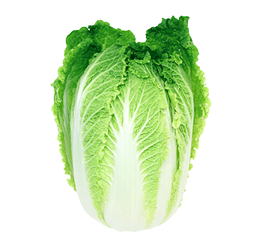
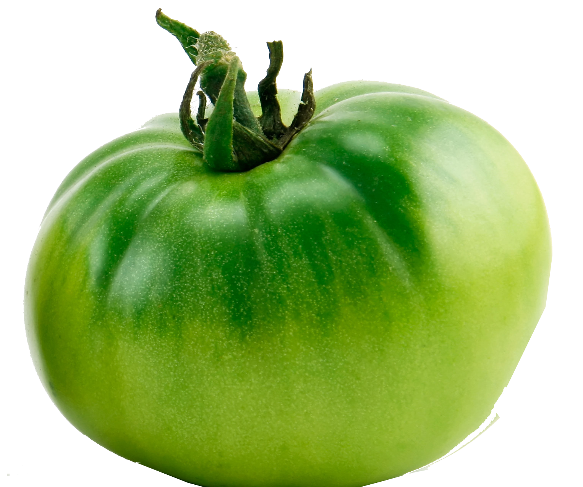

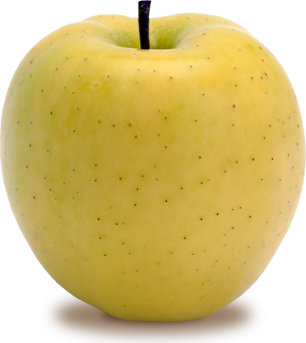

Supervised Learning
What do you see?
Notes:
You can think of the way how you know them when you are young… your mother told you this is an apple. And then after a few times training, you know that something looks like this and smell and taste like this is an apple. So these things are recognized because over time we were taught to recognize them by knowing it in different ways. And those are all associated with its names.

Slide 26
Supervised Learning
Features (Input)
Label (Output)
Color
Texture
Shape
Avg Size (in)
Sweet
Object
Green
Smooth
Oblate
4
No
Tomato
Yellow
Smooth
Round
3.5
Yes
Apple
Green
Rough
Oblate
2
No
Tomatillo
Red
Lumpy
Cylindrical
2.5
No
Chili
Green
Rough
Oblong
11
No
Cabbage
Training Data (Teacher)
Notes:
The image above demonstrates one interpretation of the fruits and vegetables into meaningful rows and columns of data, labeled data. This data represents a training data set for several labeled fruits and vegetables. Albeit small, this data set is fully capable of helping identify whether or not a newly introduced vegetable or fruit is one of the six items listed in the data set.

Slide 27
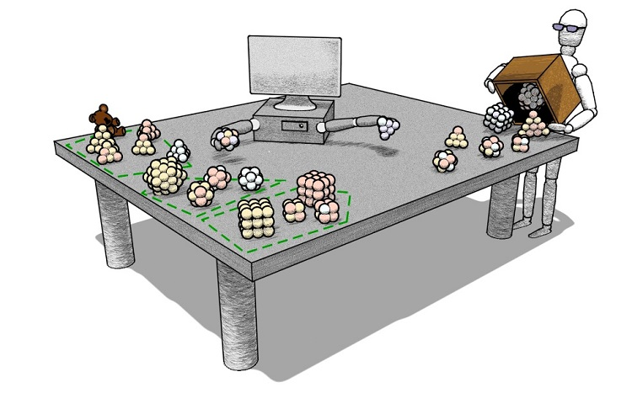
Unsupervised Learning
There is NO teacher
Correct classes of training data are NOT known
Output is natural meaningful groupings
Notes:
With unsupervised learning only the features (variables) are considered. There is no training data to train a model, the correct classifications of the data is not known, and the output is not a function but instead a natural meaningful grouping. Because labeled data is not used, there is no mechanism to evaluate the accuracy of the output. This is a key differentiator from supervised learning.

Slide 28
Unsupervised Learning
What does a machine see?
Notes:
Unlike the case of supervised learning, where the fruits and vegetable are labeled, unsupervised learning is to figure out meaningful and shared features of the fruits and vegetables. Suppose that you don’t recognize those things. You don’t know it is an apple, or pear or lettuce. But that doesn’t matter. The system doesn’t expect me to know its name. Just the next time I see it again, I will know that is the same thing I I’ve see today. So how do we have the ability to know it/ to group it as the same thing we see today? By Category or by group

Slide 29
Unsupervised Learning
Group and associate
Smooth
Rough
Green
Yellow
Red
Notes:
An unsupervised machine learning task will attempt to group objects in a meaningful way. In our example, it is not unreasonable to expect groupings by color, shape, or tactile feel. This example is overly simplistic but this may not be the case with all unsupervised machine learning tasks. Often, this approach to machine learning is used to unearth patterns in the data that may not be obvious to the naked eye or other forms of analytics.

Slide 30
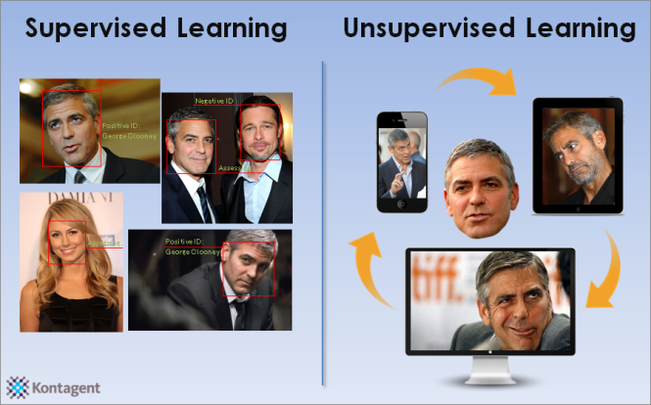
Semi-supervised Learning
Some prior knowledge
There is a teaching assistant
Large amount of data
Correct classes of training data are known for a small subset
Output is natural “meaningful” groupings
Notes:
Semi-supervised learning is the intersection of supervised and unsupervised learning. Using a small training data set along with a supervised machine learning task, a model is created to help predict, or label, data that is not labeled. In the example above, data about images of the actor George Clooney are used to train a model which can be used in conjunction with unsupervised machine learning techniques to identify George Clooney in a other images, some of which may be distorted images of this likeness.
(Another example of Facebook The best example is Facebook. If you upload a picture for the first time Facebook book will ask who is in the picture. You manually assign the correct label “this is Ashley” and then, when you upload another picture that includes Ashley, Facebook will automatically know who it is.)

Slide 31
Section 2: Summary
Key points covered in this module:
Machine Learning Terminology
Labeled and Un-Labeled Data
Main Categories of Machine Learning
Notes:
In this module, you learned key machine learning terminology, the main categories of machine learning, and the two types of data used in machine learning; labeled, and unlabeled.

Slide 32
Section 3
Approaches to Machine Learning

Slide 33
Objectives
Upon completion of this section, you should be able to:
Explain the Main Goals of Machine Learning
Discuss Various Approaches to Machine Learning
Describe When to Use One Approach Over Another
Notes:
This module provides a brief introduction to the main objectives of machine learning along with the most common approaches to machine learning. Key terminologies that distinguish between “describing” and “predicting” are discussed along with several common approaches such as classification, regression, clustering, plus others.

Slide 34
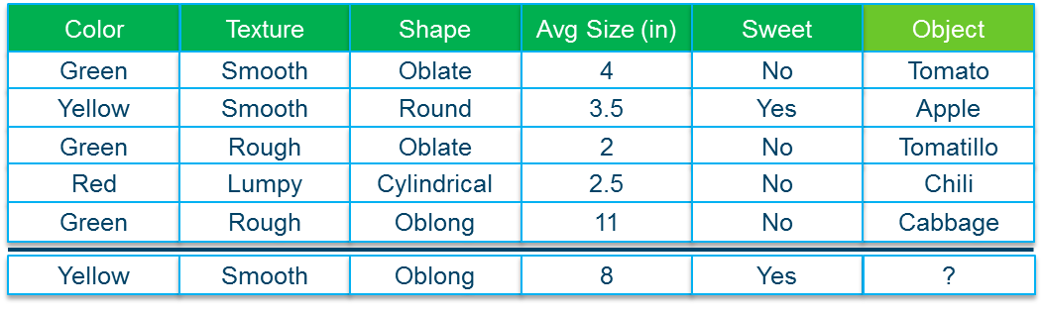
Main Goals of Machine Learning
Describe
Help to understand the relationship between the inputs and the output.
Y = golf if rain=no and day=Saturday
predict
Make predictions for a new sample described by its attributes.
Notes:
Machine learning can be described as having two main goals:
Describe: Machine learning is an important tool to help explain, or unearth hidden patterns in complex data. These patterns represent real phenomena, and with the help of machine learning can be transformed into mathematical or rule set representations that are meaningful.
Predict: With predictions, you start with a set of input variables from which you predict an output. An example of prediction includes predicting the sale price of a home based on a data set that includes the selling prices of home in its vicinity, interest rates, and demographic information about the buyer and seller.

Slide 35
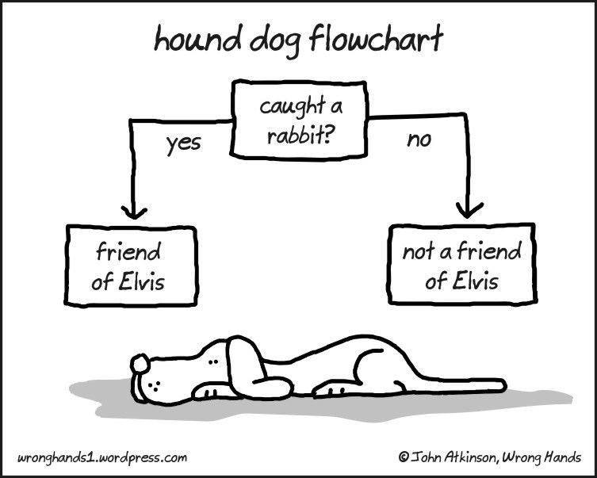
Classification
Identify group membership
Supervised learning
Predict class from observations
“friend of Elvis”
“not a friend of Elvis”
Response variable is categorical and unordered
Binary and nominal data
A Friend of Elivis⁽¹⁾
Notes:
In machine learning and statistics, classification is the problem of identifying to which of a set of categories (sub-populations) a new observation belongs, on the basis of a training set of data containing observations (or instances) whose category membership is known. An example would be assigning a given email into "spam" or "non-spam" classes or assigning a diagnosis to a given patient as described by observed characteristics of the patient (gender, blood pressure, presence or absence of certain symptoms, etc.). Classification is an example of pattern recognition. ⁽²⁾
[1]. Image: Hound Dog. http://guff.com/follow-the-fun-with-these-funny-flow-charts
[2]. Statistical Classification. https://en.wikipedia.org/wiki/Statistical_classification

Slide 36
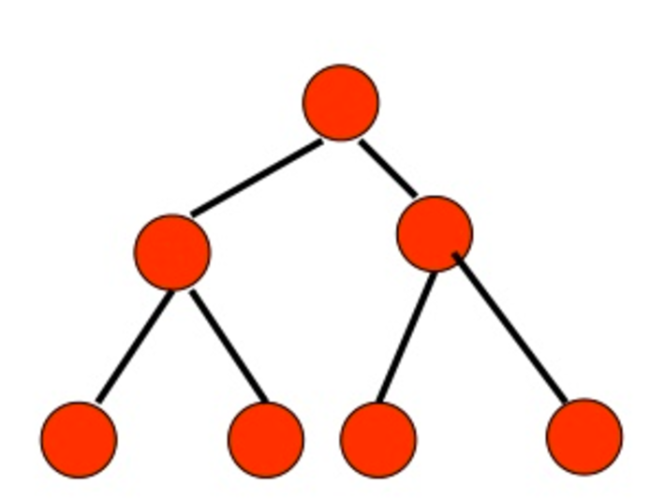
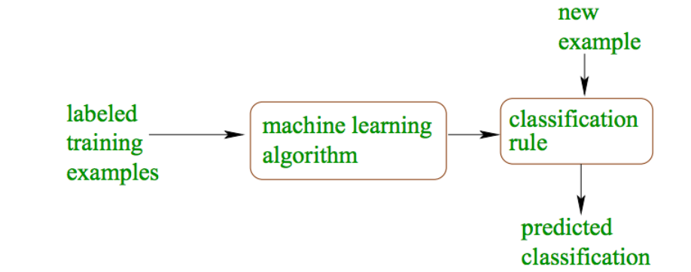
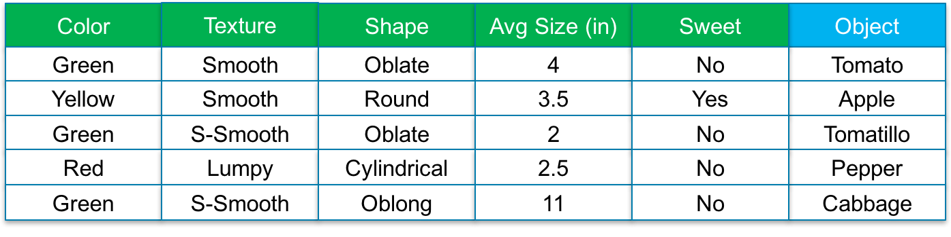
Classification
techniques
Decision Trees
Logistical Regression
Naïve Bayes
Random Forests
Tomato
Decision Trees
Notes:
“Considered to be the most popular machine learning algorithm today, decision trees are easy to interpret, easy to operationalize, and easy to visualize. When a desired outcome is a series of (yes/no) questions, decision trees offer an excellent approach to machine learning.
Reasons to choose:
Accommodates inputs of any type (numerical, categorical)
Handles highly correlated independent variables
Known existence of non-linear (complex) independent variables
Computationally efficient
Caveats:
Sensitive to small changes in training data
Target variable dependent on many independent variables
Deep trees may signal overfitting of training data” ⁽¹⁾
[1] Diertrich, D. Heller B, Yang, B. (2015). Data Science and Big Data Analytics. Indianapolis: Wiley

Slide 37
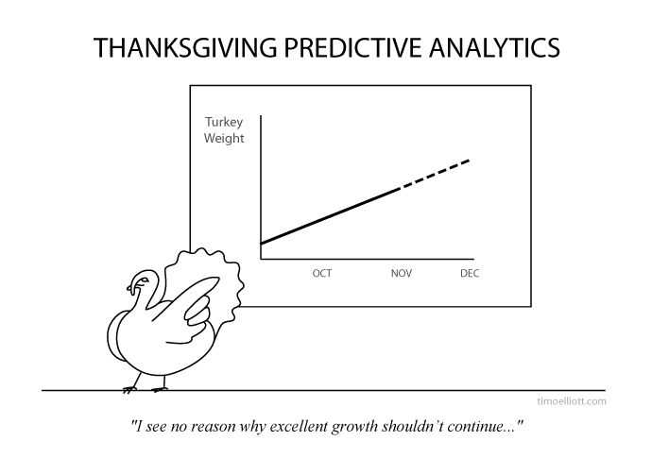
Regression
Estimate or predict a response
Supervised learning
Predict value from observations
Response variable is numeric value, or probability of class
Thanksgiving Turkey. ⁽¹⁾
Notes:
“The term "regression" was coined by Francis Galton in the nineteenth century to describe a biological phenomenon. The phenomenon was that the heights of descendants of tall ancestors tend to regress down towards a normal average (a phenomenon also known as regression toward the mean).
Specifically, regression analysis helps one understand how the value of the dependent variable (also referred to as outcome) changes when any one of the independent variables changes (also referred as drivers), while the other independent variables are held fixed. Regression analysis estimates the conditional expectation of the dependent variable given the independent variables — that is, the mean value of the dependent variable when the independent variables are held fixed.
Some example questions are :
I want to predict the lifetime value of this customer and understand what drives LTV. What drives the LTV higher or lower?
I want to predict the probability that this loan will default and understand what drives default.
Regression focuses on the relationship between the outputs and the inputs. It also provides a model that has some explanatory value, in addition to predicting outcomes.
Reasons to choose:
Robust to redundant variables, correlated variables.
Explanatory value, relative impact of each variable on the outcome.
Caveats:
Assumes that each variable affects the outcome linearly and additively (e.g. Incomes with a wide dynamic range)
Can’t handle variables that affect the outcome in a discontinuous way. (e.g. Step function)
Doesn’t work well with discrete drivers that have a lot of distinct values. (e.g. Zip codes)” ⁽²⁾
[1] Illustration. Thanksgiving Turkey. https://www.pinterest.com/mackenziecorp/predictive-analytics/
[2] Diertrich, D. Heller B, Yang, B. (2015). Data Science and Big Data Analytics. Indianapolis: Wiley

Slide 38
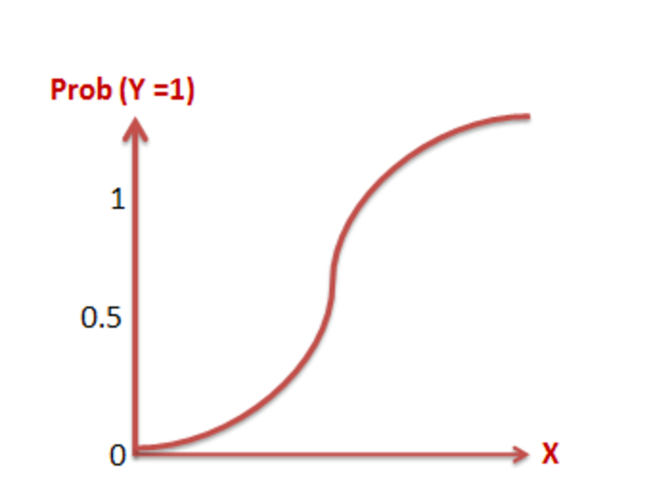
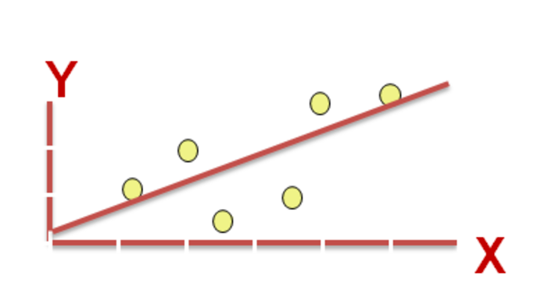
Regression
techniques
Linear Regression
Logistic Regression
How much will sales increase (Y) per unit increase of ad expense (X)
What is the change in log odds ratio (Y) per unit increase of ad expense (X)
Flavors of Regresssion⁽¹⁾
Notes:
“Regression focuses on the relationship between an outcome and its input variables:
Doesn’t just predict the outcome, it understands how changes in independent variables affect the outcome.
Outcomes can be continuous or discrete,
When discrete (Logistic Regression) the probability that the outcome will occur is the output.
When continuous, the predicted value of an outcome is the output.
Examples of the application of Linear Regression include:
Predicting household income as a function of education, age, and gender.
House price as a function of median home price in the neighborhood, square footage, number of rooms, etc.
Example of the application of Logistic Regression include:
Approval or denial of a mortgage
Customer will purchase or not purchase from website
Likelihood the New England Patriots will win the next Super bowl”⁽²⁾
[1] Images. Difference Between Regressions. http://www.listendata.com/2014/11/difference-between-linear-regression.html
[2] Diertrich, D. Heller B, Yang, B. (2015). Data Science and Big Data Analytics. Indianapolis: Wiley

Slide 39
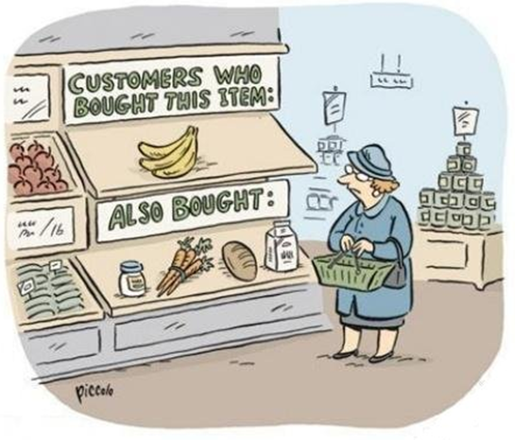
Clustering
Organize data into groups of maximum commonality
Unsupervised learning
Describe
Used for exploratory mining
Output is meaningful grouping based on similarity
Cluster Analysis ⁽¹⁾
Notes:
“Clustering is a method often used for exploratory analysis of the data. There are no ”predictions” of any values done with clustering just finding the similarity between the data and grouping them into clusters The notion of similarities can be explained with the following examples:
Consider questions such as:
How do I group these documents by topic?
How do I perform customer segmentation to allow for targeted or special marketing programs?
The definition of “similarity” is specific to the problem domain. We are defining similarity as those data points with the same “topic” tag or customers who can be profiled in to a same “age group/income/gender” or a “purchase pattern”.” ⁽²⁾
[1] http://www.kdnuggets.com/2015/12/more-data-science-humor-cartoons.html
[2] Diertrich, D. Heller B, Yang, B. (2015). Data Science and Big Data Analytics. Indianapolis: Wiley

Slide 40
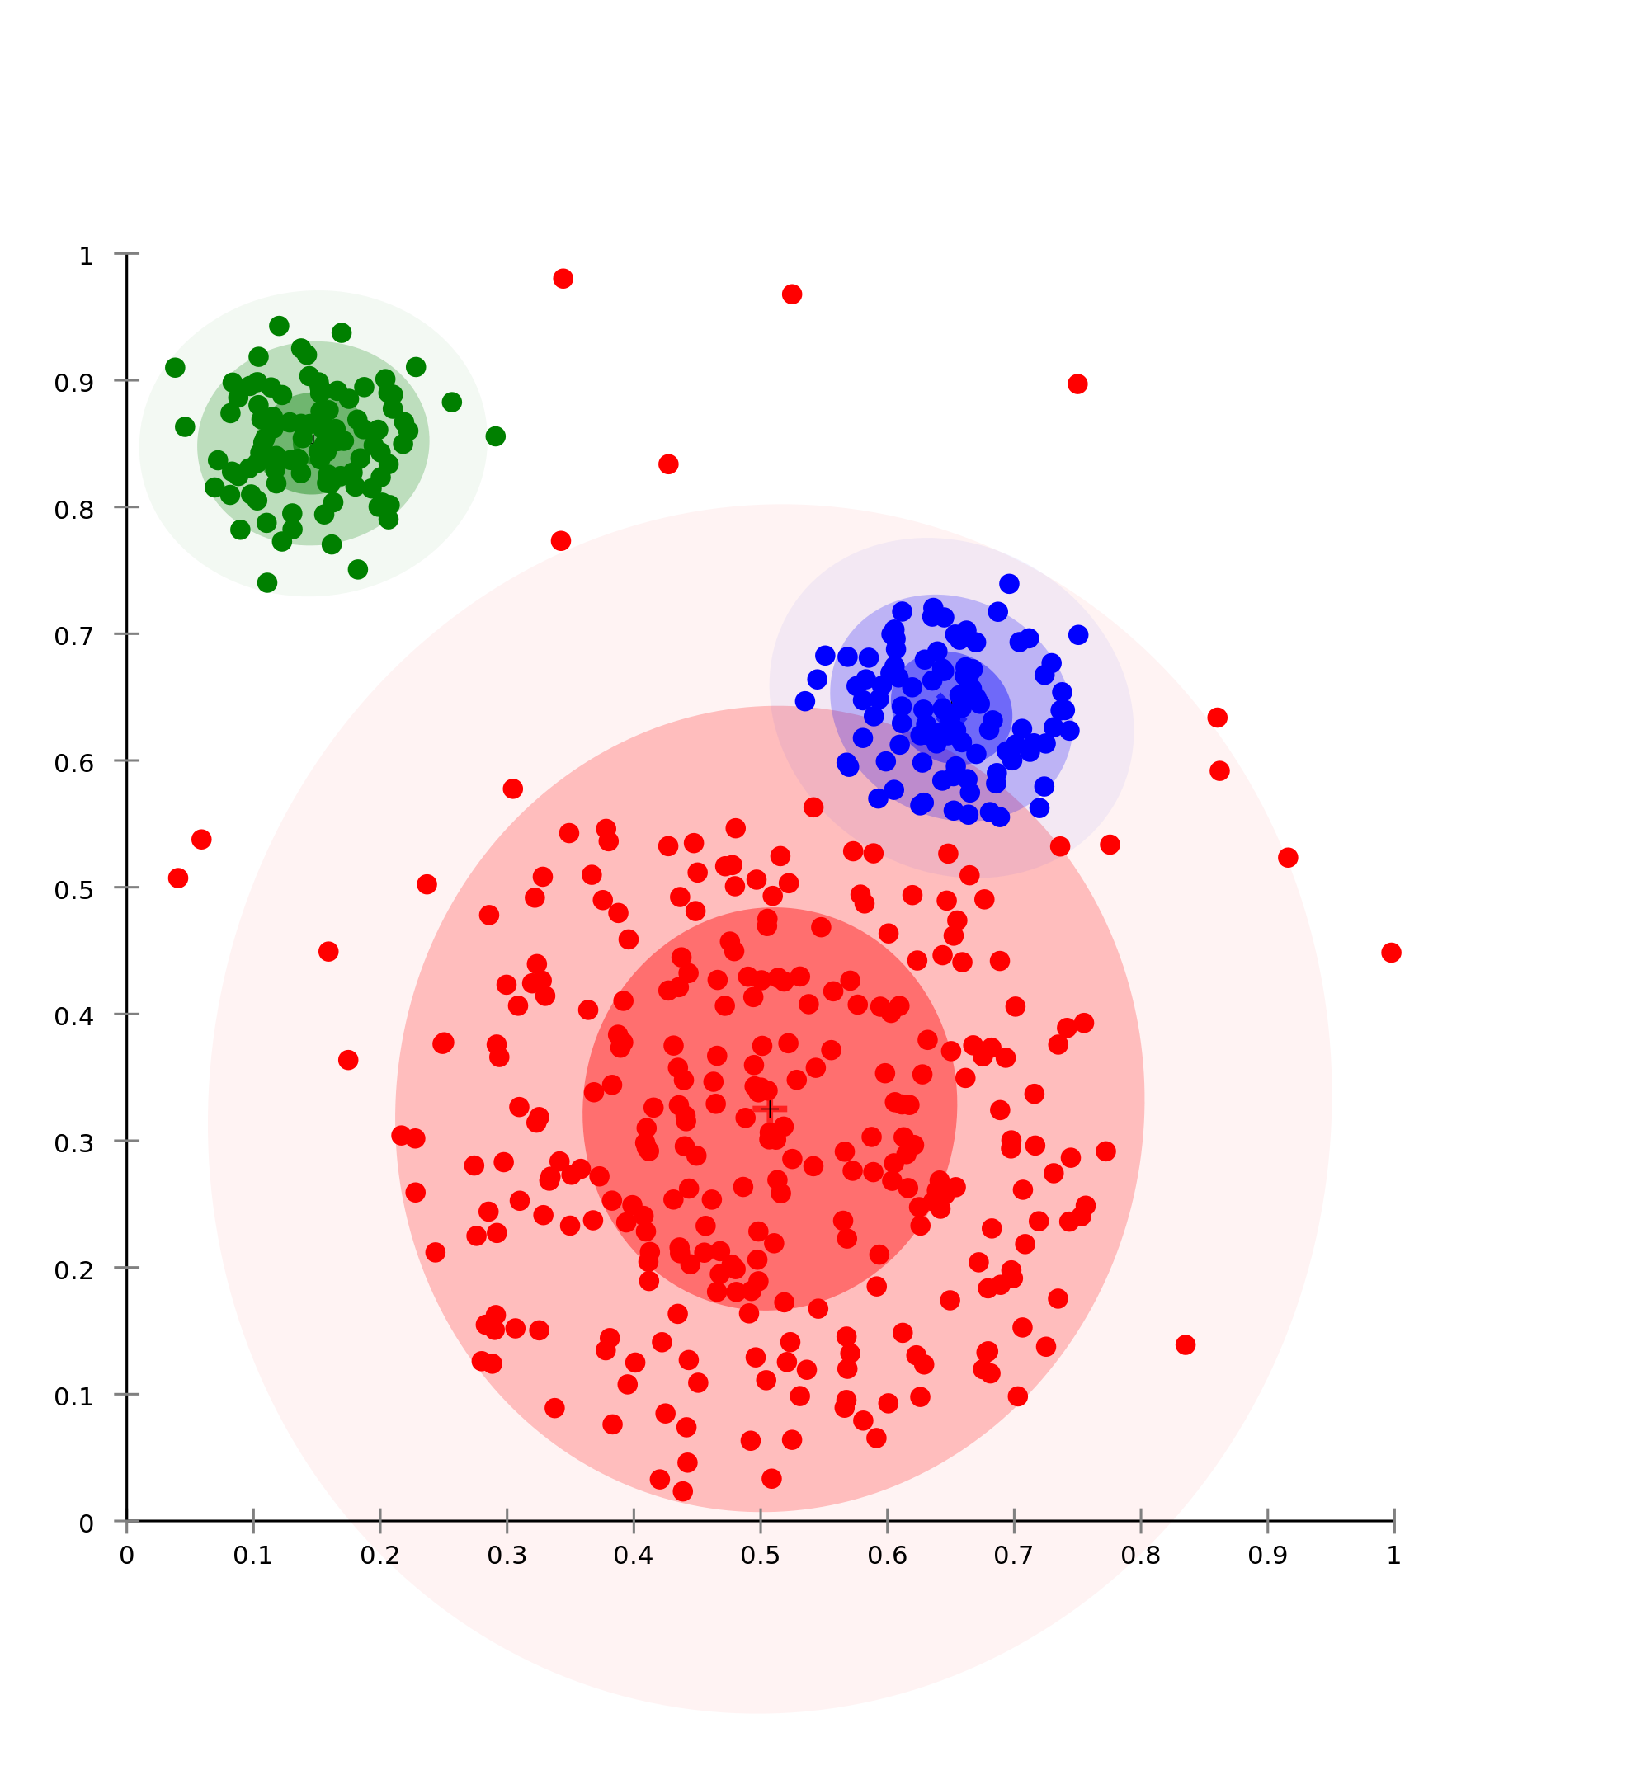
Clustering
techniques
K-Means
K-Medians
Expectation-Maximization
Hierarchical Clustering
To which centroid is a point associated?
Cluster Analysis ⁽²⁾
K-Means
Notes:
“K-means clustering is easy to implement and it produces concise output. It is easy to assign new data to the existing clusters by determining which centroid the new data point is closest to it. K refers to the number of clusters being selected.
However, K-means works only on the numerical data and does not handle categorical variables. It is sensitive to the initial guess on the centroids. It is important that the variables must be all measured on similar or compatible scales. If you measure the living space of a house in square feet, the cost of the house in thousands of dollars (that is, 1 unit is $1000), and then you change the cost of the house to dollars (so one unit is $1), then the clusters may change. K should be decided ahead of the modeling process. Wrong guesses for K may lead to improper clustering.
Reasons to choose:
Easily assign data to new clusters
Concise output
Caveats:
Sensitive to initialization
Variables should be measured on similar or compatible scales
K: The number of clusters must be known or decided beforehand” ⁽¹⁾
[1] Diertrich, D. Heller B, Yang, B. (2015). Data Science and Big Data Analytics. Indianapolis: Wiley
[2] Data Clustering. https://en.wikipedia.org/wiki/Cluster_analysis

Slide 41
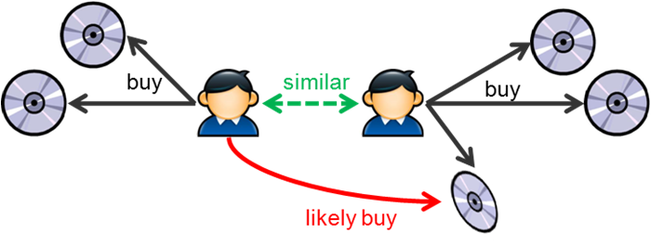
Associations
Discover strong rules along some measure
Supports labeled and unlabeled data
Describes
Data mining in large databases
First introduced to find relationships in POS systems: Market Baskets
Association Rules ⁽¹⁾
Notes:
“Association Rules is another unsupervised learning method. There is no “prediction” performed but is used to discover relationships within the data.
The example questions are:
Which of my products tend to be purchased together?
What will other people who are like this person or product tend to buy/watch or click on for other products we may have to offer?
Advertisements on X could be targeted at buyers who purchase Y
Associations Rules are intended to identify strong rules discovered in data using some measure of interestingness.” ⁽²⁾
[1] Image. Associations. http://horicky.blogspot.com/2011/09/
[2] Diertrich, D. Heller B, Yang, B. (2015). Data Science and Big Data Analytics. Indianapolis: Wiley

Slide 42
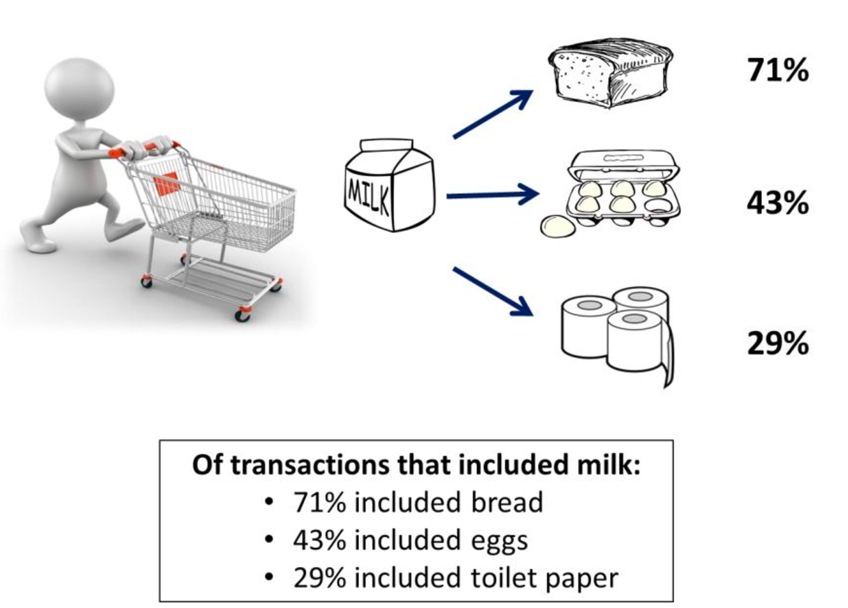
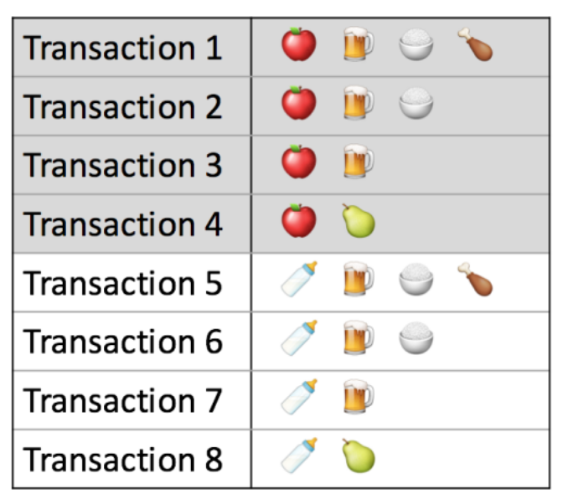
Associations
techniques
Apriori
Notes:
“Apriori algorithm uses the notion of Frequent Itemset. As the name implies, frequent itemsets are a set of items “L” that appear together “often enough”. The term “often enough” is formally defined with a support criterion where the support is defined as the percentage of transactions that contain “L”.
For example:
If we define L as a itemset {shoes, purses} and we define our “support” as 50%. If 50% of the transactions have this itemset, then we say the L is a “frequent itemset”. It is apparent that if 50% of itemsets have {shoes,purses} in them, then at least 50% of the transactions will have either {shoes} or {purses} in them. This is an Apriori property, which states that any subset of a frequent itemset is also frequent. Apriori property provides the basis for the Apriori algorithm that we will detail in the subsequent slides.” ⁽²⁾
[1] http://www.kdnuggets.com/2016/04/association-rules-apriori-algorithm-tutorial.html
[2] Diertrich, D. Heller B, Yang, B. (2015). Data Science and Big Data Analytics. Indianapolis: Wiley

Slide 43
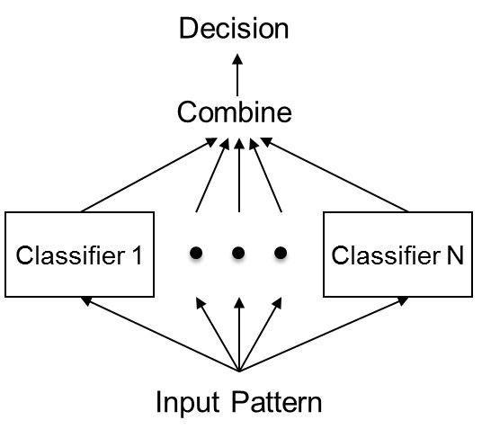
Ensembles
Combining multiple learners
Supervised learning
Weak learners independently trained
Combined predictions produce strong learner
Ensemble Methods⁽¹⁾
Winning the Netflix Prize ⁽²⁾
Notes:
“Ensemble methods are techniques that create multiple models and then combine them to produce improved results. Ensemble methods usually produces more accurate solutions than a single model would. This has been the case in a number of machine learning competitions, where the winning solutions used ensemble methods. In the popular Netflix Competition (2), the winner used an ensemble method to implement a powerful collaborative filtering algorithm.
Voting and averaging are two of the easiest ensemble methods. They are both easy to understand and implement. Voting is used for classification and averaging is used for regression. In both methods, the first step is to create multiple classification/regression models using some training dataset. Each base model can be created using different splits of the same training dataset and same algorithm, or using the same dataset with different algorithms, or any other method.” ⁽³⁾
[1] Image: Ensembles. https://img.w3cschool.cn/attachments/image/20170604/1496579056599305.jpg
[2] Netflix Prize. http://blog.echen.me/2011/10/24/winning-the-netflix-prize-a-summary/
[3] Demir, N. Ensemble Methods: Elegant Techniques to Product Improved Machine Learning Results. https://www.toptal.com/machine-learning/ensemble-methods-machine-learning

Slide 44
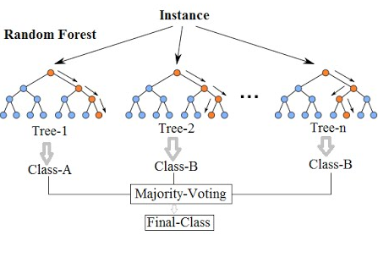
Ensembles
techniques
Random Forests
Bootstrap Aggregation
Stacked Aggregation
Random Forests⁽¹⁾
Random Forests
Notes:
Random Forests are ensembles of decision trees that leverage the power of a randomized strategy and results in a strong learner. This approach is highly accurate and computationally efficient.
The term “Random Forests” is trademarked by its inventors Leo Breiman and Adele Cutler.
For a given dataset with N observations, each decision tree in the forest is built or trained using a random sample with replacement of size N. This process is referred to as bootstrap aggregation or bagging, for short. Any observations not included in an individual sample is called out of bag (OOB) data. For fairly large N, one would expect about 37% of the observations to be OOB data.
In general, a Random Forests model does not require cross-validation or a separate testing data set to determine an estimate of error, this functionality is part of the Random Forests algorithm. ⁽²⁾
[1] Image: Random Forests. https://i.ytimg.com/vi/ajTc5y3OqSQ/hqdefault.jpg
[2] Breiman, L. (2001). Random Forests. https://www.stat.berkeley.edu/~breiman/randomforest2001.pdf

Slide 45
Method Summary
Method | Type | Goal | Input | Output | Algorithm Examples
Classification | Supervised | Predict class | Binary Nominal | Unordered categorical | Decision tree Logistic regression Naïve bayes Random forests
Regression | Supervised | Predict value Predict probability | Numeric | Numeric Probability | Linear regression Logistic regression
Clustering | Unsupervised | Describe data | Numeric | Grouping by similarity | K-Means K-Medians Expectation-Maximization Hierarchical Clustering
Association | Unsupervised | Describe data | Numeric Categorical | Associated item | Apriori
Ensemble | Supervised | Describe data Predict group Predict value Predict probability | Binary Nominal Numeric | Categorical Numerical Similarity | Random forests Bootstrap aggregation Stacked aggregation

Slide 46
Section 3: Summary
Key points covered in this section:
Main Goals of Machine Learning
Various Approaches to Machine Learning
Applicability of Each Approach
Notes:
In this module you learned the main goals of machine learning and its various approaches. You also learned how each approach is used and when they are appropriate.

Slide 47
Sections 4
Lab – Predicting Customer Churn

Slide 48


Slide 49
Appendix
Glossary

Slide 50
Glossary
Analytics | The quantifiable informational inputs that use past data to identify possible trends that may provide valuable insight for future action.
Association Rules | Unsupervised learning technique to find similarities in data items based on frequent item sets. It does not predict but is used for data exploration. Most common example is market basket analysis.
Classification | Supervised learning technique that identifies to which of a set of categories a new observation belongs, on the basis of a training set of data containing observations whose category membership is known.
Clustering | Unsupervised learning technique to find similarities based on the proximity of features in a dataset. It cannot make predictions and is used for data exploration.
Collinearity | Refers to a linear relationship between two or more independent variables (multi-collinearity). When this exists in a data set, it can cause a model to be less accurate.
Correlation | Statistical relationship that involves dependence and is most often used in reference to a linear relationship. Example: Price and Demand.

Slide 51
Glossary (cont.)
Data | Raw objective fact about an event.
Data Science | Interdisciplinary field about scientific methods, processes, and systems to extract knowledge or insights from data in various forms, either structured or unstructured.
Dependent Variable | The value of the variable is influenced by other variables. Also referred to as the outcome or target.
Descriptive Statistics | Methods of organizing, summarizing and presenting information about data.
Ensemble | Machine learning technique that combines multiple models (weak learners) to make an overall strong learner. The models may use all the same or different algorithms and the training data may be all the same or resampled. Most common example is Random Forests.
Independent Variable | The value of the variable is not influenced by other variables. These variables may influence dependent variables.

Slide 52
Glossary (cont.)
Inferential Statistics | Methods to determine something about a population from a sample.
Information | Data with interpretation: useful, organized, and structured.
Knowledge | Information with context, it has understanding and meaning.
Kurtosis | A measure of the "tailedness" of the probability distribution of a real-valued random variable.
Labeled Data | Data that has been identified and assigned a label.
Machine Learning | The field of study that gives computers the ability to learn without being explicitly programmed.
Mean | The quotient of the sum of the data points and the number of data points; another name for the average.
Median | When the data are arranged in sorted order, the median is that data point at which 50% of the data points are either less than or greater than that data point; the data point in the middle.

Slide 53
Glossary (cont.)
Mode | The data point that occurs most frequently. There can be more than one mode.
Quasi-Structured Data | Textual data with erratic data formats, can be formatted with effort, tools, and time.
Semi-Structured Data | Textual data with a discernable pattern, enabling parsing. E.g. Self-describing XML with schema.
Semi-Supervised Learning | Category of machine learning that uses few labeled data, and many unlabeled data. There is a teaching assistant, usually involves large amounts of unclassified data with few classified data. The output is a meaningful grouping of data.
Skewness | A measure of the asymmetry a data distribution. A measure of 0 indicates a perfect symmetry.
Structured Data | Defined data type, format, and structure. E.g. Transactional Data.

Slide 54
Glossary (cont.)
Semi-Supervised Learning | Category of machine learning that uses few labeled data, and many unlabeled data. There is a teaching assistant, usually involves large amounts of unclassified data with few classified data. The output is a meaningful grouping of data.
Unlabeled Data | Refers to data that has no clear label or indication of what it is.
Unstructured Data | Data that has no inherent structure and is usually stored in different file types. E.g. PDF, Excel, and JPG.
Unsupervised Learning | Category of machine learning that only uses all unlabeled data. There is no teacher, the correct classes of training data are not known, and the output is a natural meaningful grouping of the data.
Wisdom | Knowledge with insight. Integrated understanding and actionable.

